Slide 1
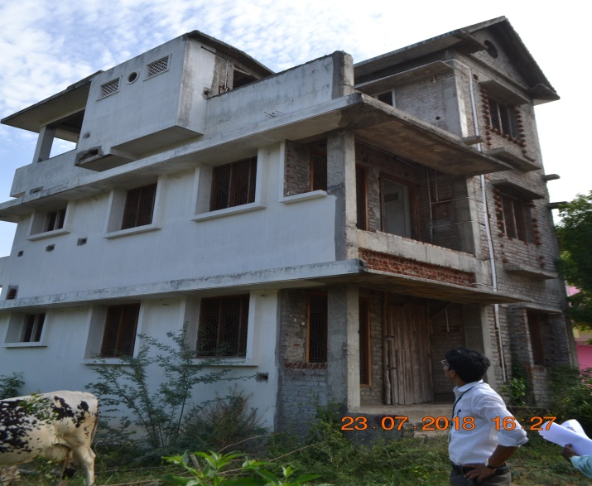
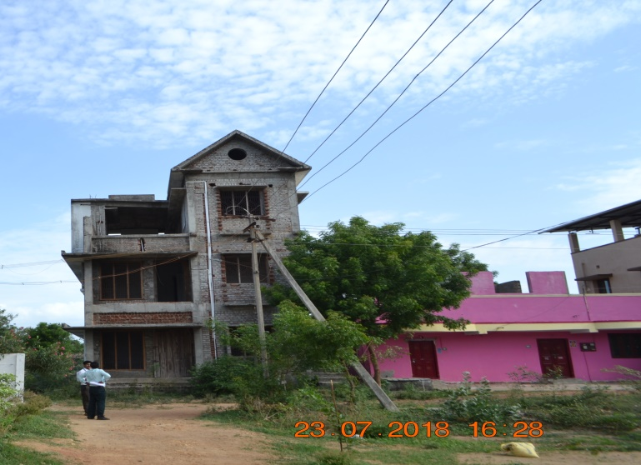
RESIDENTIAL BUILDING
RESB - 001
Location of Property | THANJAVUR
Total area of land | 1032.50 sq.ft
Constructed area | Ground floor – 707sq.ft. First floor – 618sq.ft
Year of construction | 2012
Current market value | Rs. 21.92 lacs

Slide 2
RESIDENTIAL FLAT
RESB - 002
Location of Property | NANGANALLUR
Total area of flat | 974 sq.ft (UDS-625 sq.ft )
Constructed area | First floor – 974sq.ft
Year of construction | 2004
Current market value | Rs. 29.00 lacs

Slide 3
RESIDENTIAL FLAT
RESB - 003
Location of Property | MANGADU
Total area of flat | 982 sq.ft (UDS-450 sq.ft )
Constructed area | First floor – 982sq.ft
Year of construction | New
Current market value | Rs. 29.00 lacs

Slide 4
RESIDENTIAL FLAT
RESB - 004
Location of Property | THIRUMULLAIVOYAL
Total area of flat | 1354 sq.ft (UDS-888 sq.ft )
Constructed area | Ground floor &First floor – 1354sq.ft
Year of construction | 2010
Current market value | Rs. 39.00 lacs

Slide 5
RESIDENTIAL FLAT
RESB - 005
Location of Property | AMBATTUR
Total area of flat | 910 sq.ft (UDS-455 sq.ft )
Constructed area | First floor – 910sq.ft
Year of construction | New
Current market value | Rs. 29.00 lacs

Slide 6
RESIDENTIAL FLAT
RESB - 006
Location of Property | MADHAVARAM
Total area of flat | 1140 sq.ft (UDS-682 sq.ft )
Constructed area | First floor – 1140 sq.ft
Year of construction | 2010
Current market value | Rs. 69.00 lacs

Slide 7
RESIDENTIAL BUILDING
RESB - 007
Location of Property | KANCHEEPURAM
Total area of flat | 4356 sq.ft
Constructed area | Ground floor – 2134 sq.ft
Year of construction | 2011
Current market value | Rs. 93.00 lacs

Slide 8
RESIDENTIAL BUILDING
RSEB - 008
Location of Property | TRIPLICANE
Total area of flat | 2100 sq.ft (USD-770 sq.ft)
Constructed area | First floor – 2100 sq.ft
Year of construction | New
Current market value | Rs. 125.80 lacs

Slide 9
RESIDENTIAL BUILDING
RSEB - 009
Location of Property | MEDIPAKKAM
Total area of flat | 677 sq.ft (UDS-305.50 sq.ft)
Constructed area | First floor – 677 sq.ft
Year of construction | 2005
Current market value | Rs. 32.70 lacs

Slide 10
RESIDENTIAL FLAT
RESB - 010
Location of Property | URAPAKKAM
Total area of flat | 1317 sq.ft (UDS-816 sq.ft)
Constructed area | First floor – 1317 sq.ft
Year of construction | 2011
Current market value | Rs. 57.70 lacs

Slide 11
RESIDENTIAL FLAT
RESB - 011
Location of Property | Chengalpet
Total area of flat | 975 sq.ft (UDS-409 sq.ft)
Constructed area | First floor – 975 sq.ft
Year of construction | New
Current market value | Rs. 36.12 lacs

Slide 12
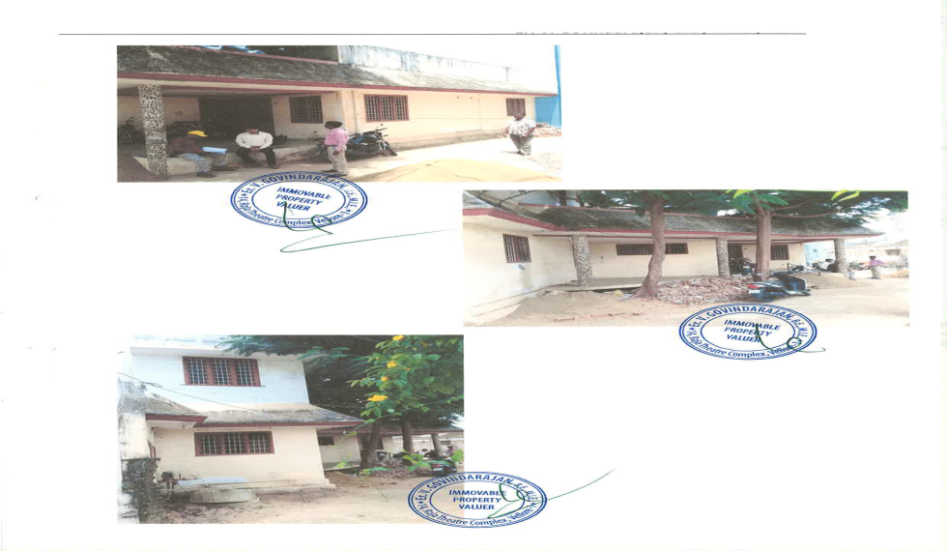
RESIDENTIAL BUILDING
RSEB - 012
Location of Property | VANIYAMBADI VELLORE
Total area of flat | 2073 sq.ft
Constructed area | Ground floor – 78.27 sq.m
Year of construction | 1998
Current market value | Rs. 34.50 lacs

Slide 13
RESIDENTIAL BUILDING
RSEB - 013
Location of Property | BHARANIPUTHUR KANCHIPURAM
Total area of flat | 1224 sq.ft
Constructed area | Ground floor – 601 sq.ft
Year of construction | 2009
Current market value | Rs. 21.28 lacs

Slide 14
RESIDENTIAL FLAT
RESB - 014
Location of Property | VELACHERY
Total area of flat | 305 sq.ft
Constructed area | Ground floor – 850 sq.ft
Year of construction | 2007
Current market value | Rs. 39.78 lacs

Slide 15
RESIDENTIAL BUILDING
RSEB - 015
Location of Property | TAMBARAM WEST
Total area of flat | 2765 sq.ft
Constructed area | Ground floor& First Floor – 1565sq.ft
Year of construction | 2008
Current market value | Rs. 146.00 lacs

Slide 16
RESIDENTIAL FLAT
RESB - 016
Location of Property | ANNA NAGAR WEST
Total area of flat | 880 (UDS) sq.ft
Constructed area | Second Floor – 880sq.ft
Year of construction | 1996
Current market value | Rs. 29.37 lacs

Slide 17
RESIDENTIAL FLAT
RESB - 017
Location of Property | POONAMALLEE
Total area of flat | 275 (UDS) sq.ft
Constructed area | First Floor – 651sq.ft
Year of construction | 2013
Current market value | Rs. 22.80 lacs

Slide 18
RESIDENTIAL FLAT
RESB - 018
Location of Property | Triplicane
Total area of flat | 1179 sq.ft
Constructed area | Ground Floor & First floor – 1532 sq.ft
Year of construction | 2006
Current market value | Rs. 143.57 lacs

Slide 19
RESIDENTIAL FLAT
RESB - 019
Location of Property | Chitlapakam
Total area of flat | 400 sq.ft(UDS)
Constructed area | Second floor – 850 sq.ft
Year of construction | 2013
Current market value | Rs. 42.00 lacs

Slide 20
RESIDENTIAL FLAT
RESB - 020
Location of Property | THIRUVALLUR
Total area of flat | 368 sq.ft(UDS) 2361 sq.ft
Constructed area | Ground floor &First floor – 920 sq.ft
Year of construction | 2015
Current market value | Rs. 19.09 lacs

Slide 21
RESIDENTIAL FLAT
RESB - 021
Location of Property | KAVANUR, GUDUVANCHERY
Total area of flat | 325 sq.ft(UDS)
Constructed area | Second floor – 692 sq.ft
Year of construction | 2012
Current market value | Rs.9.70 lacs

Slide 22
RESIDENTIAL FLAT
RESB - 022
Location of Property | UTHUKOTTAI,THIRUVALLUR
Total area of flat | 309 sq.ft(UDS) 855 sq.ft
Constructed area | Second floor – 514 sq.ft
Year of construction | 2012
Current market value | Rs.5.80 lacs

Slide 23
RESIDENTIAL FLAT
RESB - 023
Location of Property | UTHUKOTTAI,THIRUVALLUR
Total area of flat | 309 sq.ft(UDS) 855 sq.ft
Constructed area | Second floor – 514 sq.ft
Year of construction | 2012
Current market value | Rs.5.80 lacs

Slide 24
RESIDENTIAL FLAT
RESB - 024
Location of Property | UTHUKOTTAI,THIRUVALLUR
Total area of flat | 309 sq.ft(UDS) 855 sq.ft
Constructed area | Second floor – 514 sq.ft
Year of construction | 2012
Current market value | Rs.5.80 lacs

Slide 25
RESIDENTIAL FLAT
RESB - 025
Location of Property | UTHUKOTTAI,THIRUVALLUR
Total area of flat | 258 sq.ft(UDS) 716 sq.ft
Constructed area | Ground floor – 501 sq.ft
Year of construction | 2013
Current market value | Rs.5.80 lacs

Slide 26
RESIDENTIAL FLAT
RESB - 026
Location of Property | UTHUKOTTAI,THIRUVALLUR
Total area of flat | 309 sq.ft(UDS) 726 sq.ft
Constructed area | Second floor – 514 sq.ft
Year of construction | 2012
Current market value | Rs.5.80 lacs

Slide 27
RESIDENTIAL FLAT
RESB - 027
Location of Property | UTHUKOTTAI,THIRUVALLUR
Total area of flat | 220 sq.ft(UDS) 524 sq.ft
Constructed area | First floor – 358 sq.ft
Year of construction | 2013
Current market value | Rs.7.33 lacs

Slide 28
RESIDENTIAL FLAT
RESB - 028
Location of Property | SEVVAPET,THIRUVALLUR
Total area of flat | 300 sq.ft(UDS) 810 sq.ft
Constructed area | First floor – 675 sq.ft
Year of construction | 2013
Current market value | Rs.9.72 lacs

Slide 29
RESIDENTIAL BUILDING
RSEB - 029
Location of Property | ARUMBAKKAM,CHENNAI
Total area of flat | 704 sq.ft
Constructed area | Ground floor – 520 sq.ft
Year of construction | 2001
Current market value | Rs.37.00 lacs

Slide 30
RESIDENTIAL BUILDING
RSEB - 030
Location of Property | PAKKAM, THIRUVALLUR
Total area of flat | 2192 sq.ft
Constructed area | Ground floor & First floor – 3418 sq.ft
Year of construction | 1998
Current market value | Rs. 41.32 lacs

Slide 31
RESIDENTIAL BUILDING
RSEB - 031
Location of Property | MADIPAKKAM, CHENNAI
Total area of flat | 2539 sq.ft
Constructed area | Ground floor & First floor – 2539 sq.ft
Year of construction
Current market value | Rs. 119.28 lacs

Slide 32
RESIDENTIAL BUILDING
RSEB- 032
Location of Property | WASERMENPET, CHENNAI
Total area of land | 5051 sq.ft
Constructed area
Year of construction | 1989
Current market value | Rs. 187.41 lacs

Slide 33
RESIDENTIAL FLAT
RESB - 033
Location of Property | VELACHERY
Total area of flat | 300 sq.ft(UDS)
Constructed area | Ground floor – sq.ft
Year of construction | 2012
Current market value | Rs.35.66 lacs

Slide 34
RESIDENTIAL BUILDING
RSEB - 034
Location of Property | POONAMALLEE
Total area of flat | 2000 sq.ft
Constructed area | Ground floor – 1102 sq.ft
Year of construction | 2013
Current market value | Rs.43.00 lacs

Slide 35
RESIDENTIAL BUILDING
RSEB - 035
Location of Property | PORUR
Total area of flat | 995.50 sq.ft
Constructed area | Ground floor – 1314 sq.ft
Year of construction
Current market value | Rs.60.00 lacs

Slide 36
RESIDENTIAL BUILDING
RSEB- 036
Location of Property | MOGAPPAIR,CHENNAI
Total area of land | 468 sq.ft
Constructed area | 700 sq.ft
Year of construction | 1991
Current market value | Rs. 44.26 lacs

Slide 37
RESIDENTIAL BUILDING
RSEB- 037
Location of Property | VANIYAMBADI,VELLORE
Total area of land | 7505 sq.ft
Constructed area | sq.ft
Year of construction
Current market value | Rs. 131.43 lacs

Slide 38
RESIDENTIAL LAND & BUILDING
RSEB- 038
Location of Property | MUTHIYAPET, CHENNAI
Total area of land | 3977 sq.ft
Constructed area
Year of construction
Current market value | Rs. 405.70 lacs

Slide 39
RESIDENTIAL LAND & BUILDING
RSEB- 039
Location of Property | KATTINARAYANAPALLI,KRISHNAGIRI
Total area of land | 7840 sq.ft
Constructed area | Ground floor & First floor- 2018.80 sq.ft
Year of construction | 2014
Current market value | Rs. 53.66 lacs

Slide 40
RESIDENTIAL LAND & BUILDING
RSEB- 040
Location of Property | HOSUR,KRISHNAGIRI
Total area of land | 1200 sq.ft
Constructed area | Ground floor & First floor- 1404 sq.ft
Year of construction | 2015
Current market value | Rs. 33.27 lacs

Slide 41
RESIDENTIAL LAND & BUILDING
RSEB- 041
Location of Property | DENKANIKTTA,KRISHNAGIRI
Total area of land | 1530 sq.ft
Constructed area | Ground floor & First floor- 1884 sq.ft
Year of construction | 2015
Current market value | Rs. 40.04 lacs

Slide 42
RESIDENTIAL LAND & BUILDING
RSEB- 042
Location of Property | PALACODE,DHARMAPURI
Total area of land | 3092 Sq.ft
Constructed area | Ground Floor & First Floor- 1964.25 sq.ft
Year of construction | 1985
Current market value | Rs. 24.53 lacs

Slide 43
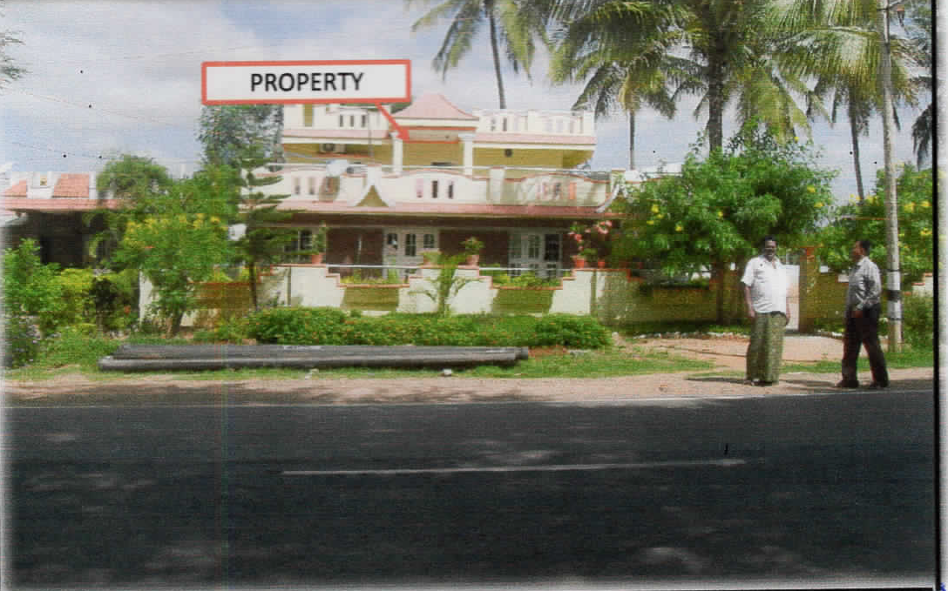
RESIDENTIAL LAND & BUILDING
RSEB- 043
Location of Property | PALACODE,DHARMAPURI
Total area of land | Sq.ft
Constructed area | Ground Floor & First Floor- sq.ft
Year of construction
Current market value | Rs. lacs

Slide 44
RESIDENTIAL LAND & BUILDING
RSEB- 044
Location of Property | PALACODE,DHARMAPURI
Total area of land | Sq.ft
Constructed area | Ground Floor & First Floor- sq.ft
Year of construction
Current market value | Rs. lacs

Slide 45
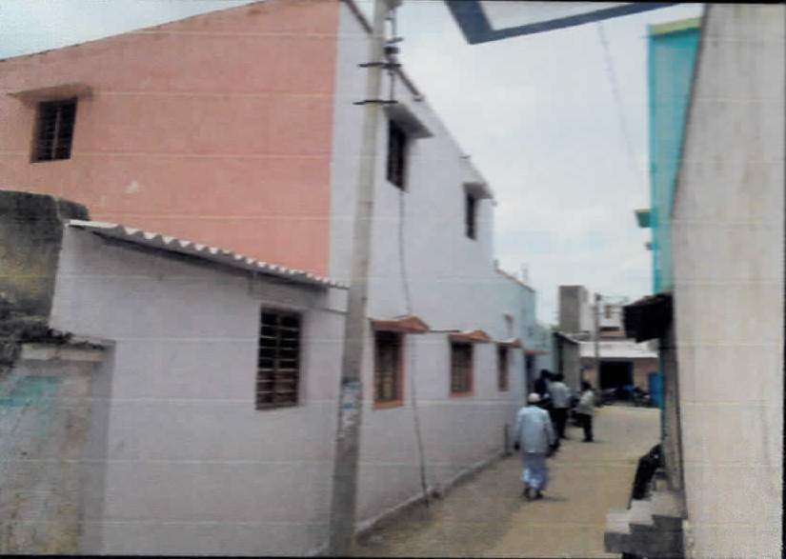
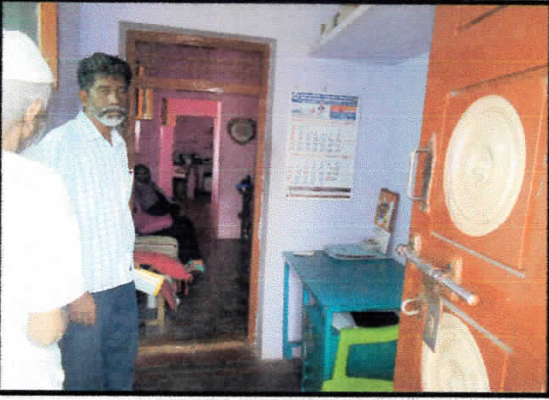
RESIDENTIAL LAND & BUILDING
RSEB- 045
Location of Property | PALACODE,DHARMAPURI
Total area of land | Sq.ft
Constructed area | Ground Floor & First Floor- sq.ft
Year of construction
Current market value | Rs. lacs

Slide 46
RESIDENTIAL LAND & BUILDING
RSEB- 046
Location of Property | MORAPPUR,DHARMAPURI
Total area of land | 1500 Sq.ft
Constructed area | Ground Floor & First Floor- 1579.50sq.ft
Year of construction | 2012
Current market value | Rs. 26.90 lacs

Slide 47
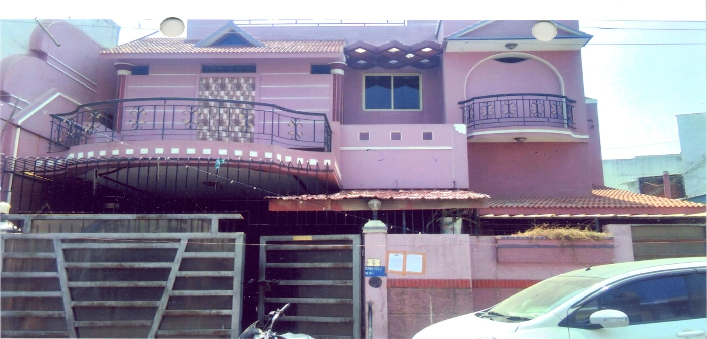
RESIDENTIAL BUILDING
RESB - 047
Location of Property | AMBUR
Total area of land | 2380 sq.ft
Constructed area | 2361 sq.ft
Year of construction | 2000
Current market value | Rs. 129.00 lacs

Slide 48
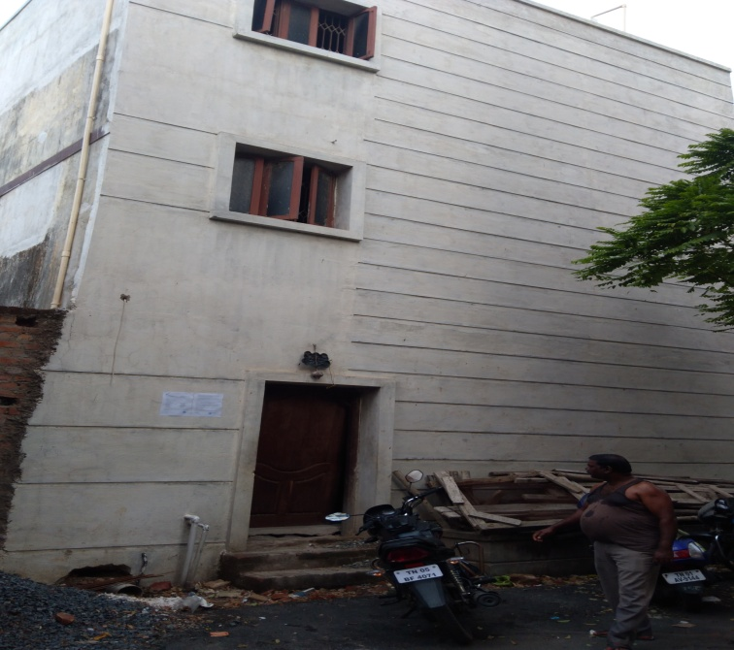
RESIDENTIAL BUILDING
RESB - 048
Location of Property | PURASAWALKAM
Total area of land | 1058 sq.ft
Constructed area | 1058 sq.ft
Year of construction
Current market value | Rs.

Slide 49
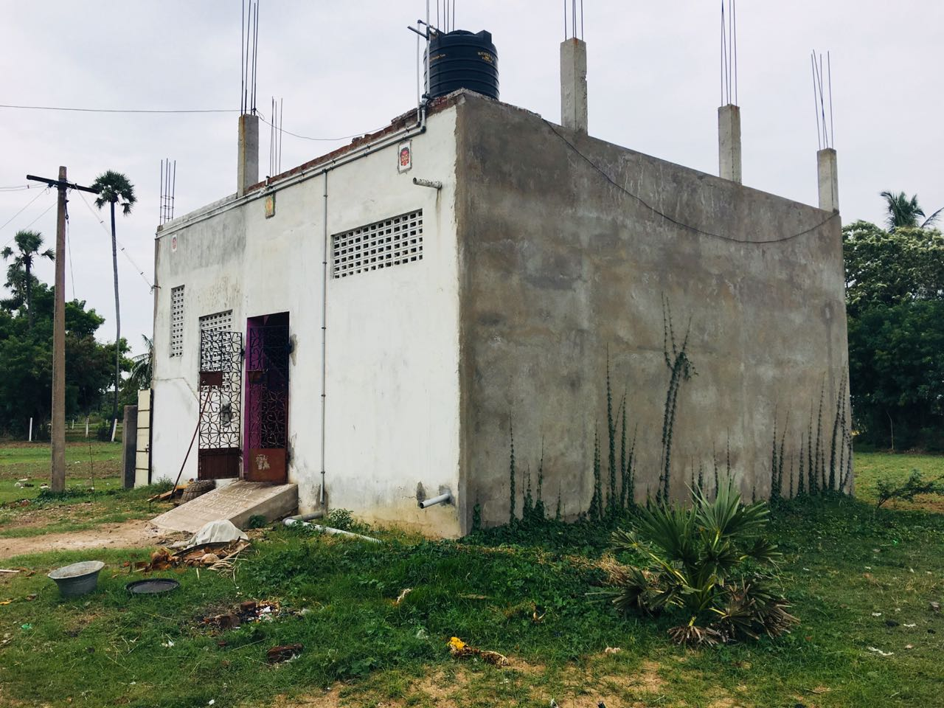
RESIDENTIAL BUILDING
RESB - 049
Location of Property | MATHUR,TIRUVANNAMALAI
Total area of land | 900 sq.ft
Constructed area | 594 sq.ft
Year of construction | 2015
Current market value | Rs. 12.48 Lacs

Slide 50
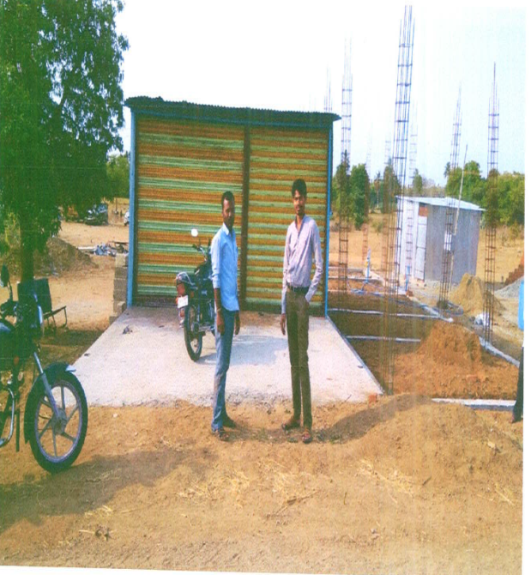
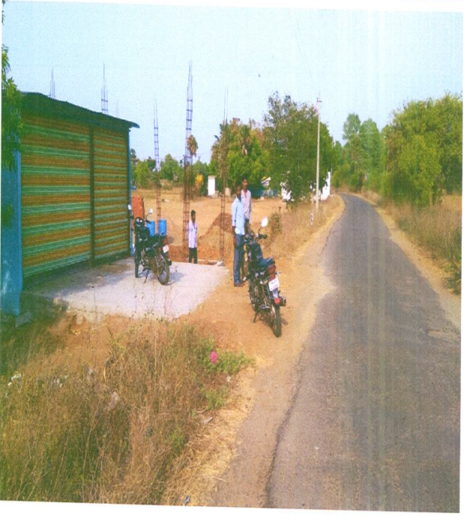
RESIDENTIAL BUILDING
RESB - 050
Location of Property | TIRUVANNAMALAI/WANDIWASH
Total area of land | 3488 Sqft
Constructed area | 929 Sqft
Year of construction | 2004
Current market value | Rs. 10.75 Lacs

